Slide 1

Concept of Convolution Neural Network
CNN most commonly applied to analyze visual imagery
Similar to human eye registers the information only in the confined receptive frame and learns the specific patterns and spatial features
For example- Apple recognition from childhood based on shape, size, color etc

Slide 2
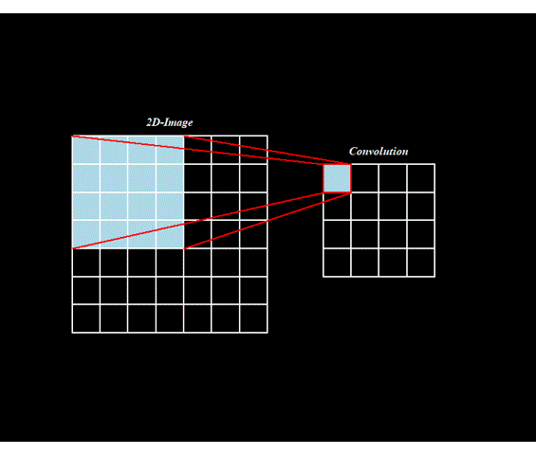
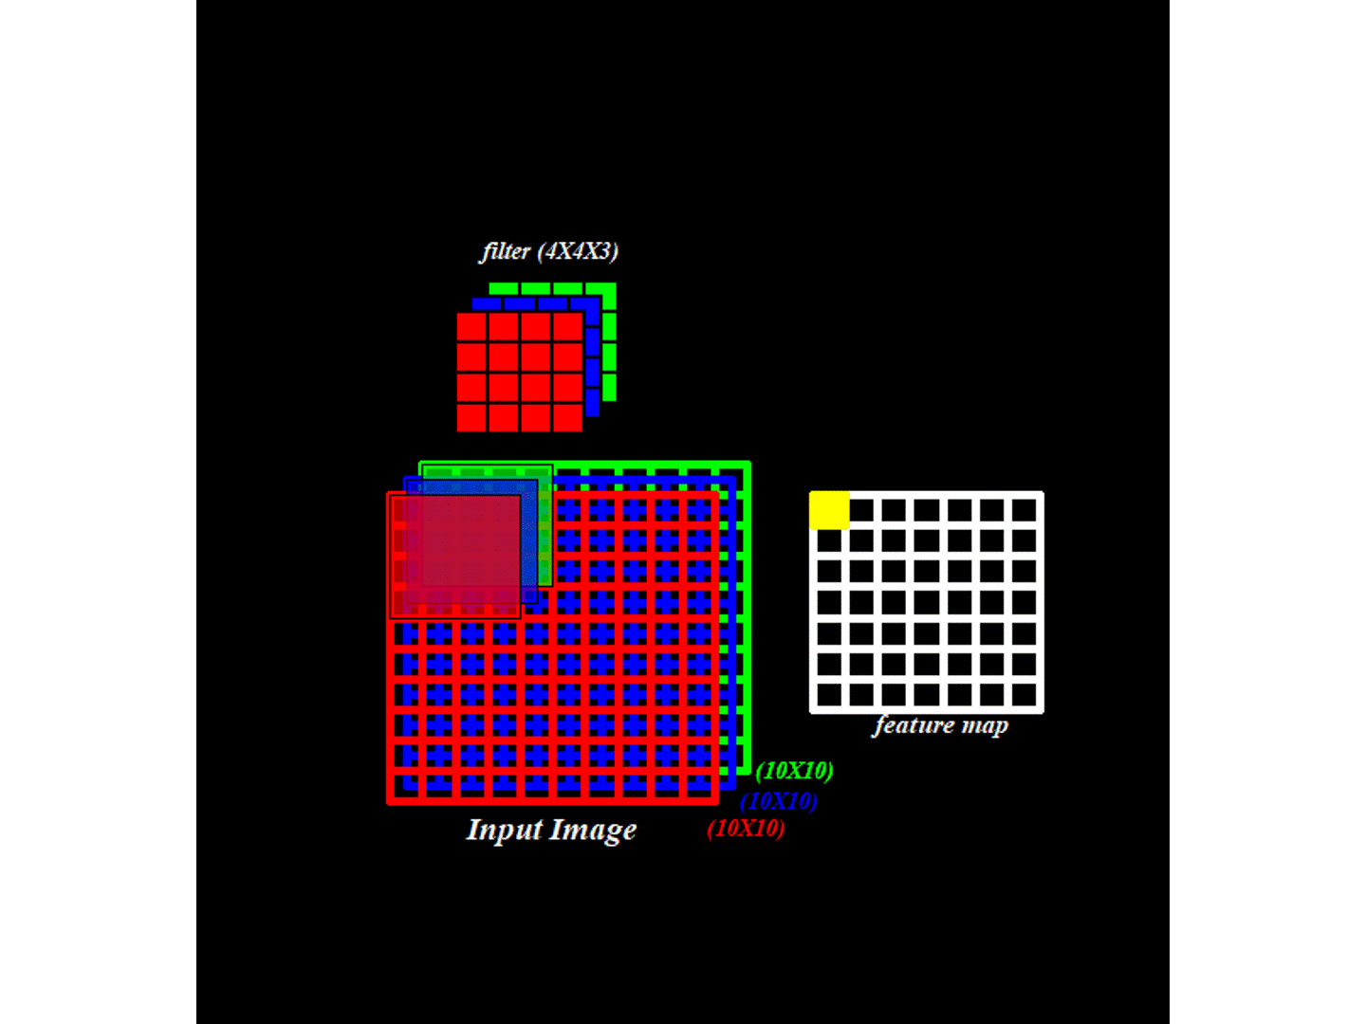
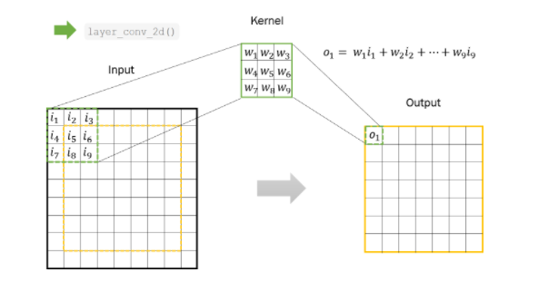
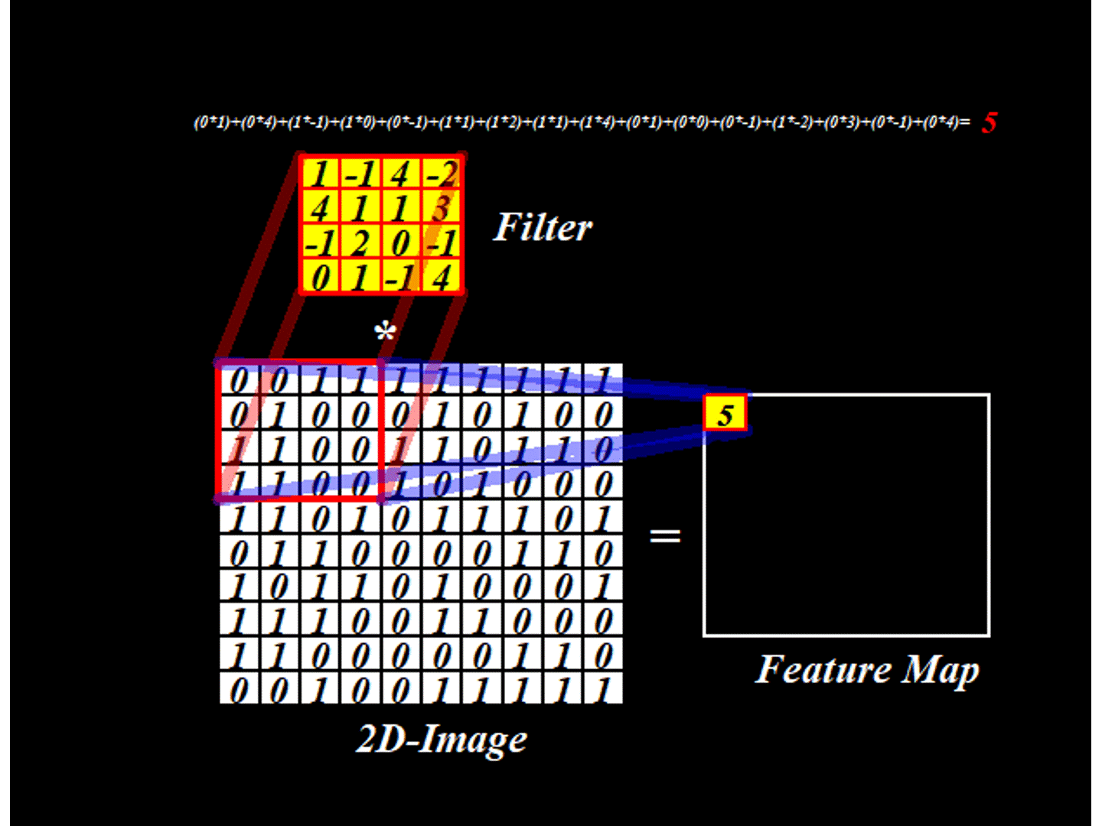
Convolution layer

Slide 3
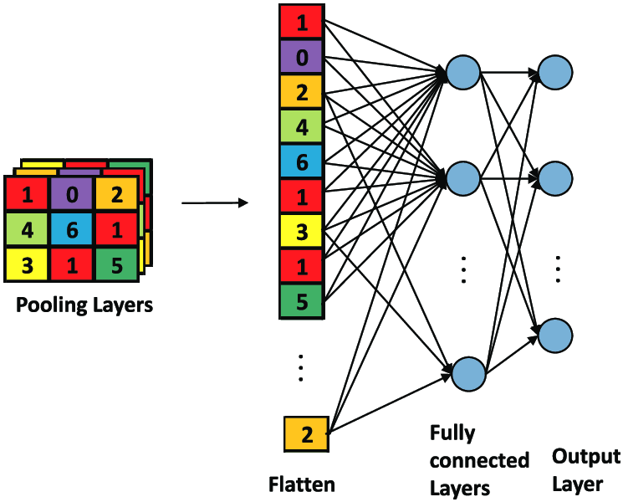

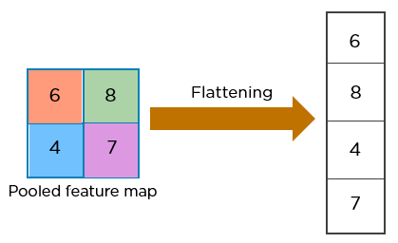
Pooling Layer
Flatten Layer
Dense Layer
Back propagation

Slide 4

Simple CNN
Simple configuration-
One input layer
Few convolution + pooling layer
One flatten layer to activate the neurons in the middle
Few dense layer, and
One output layer

Slide 5
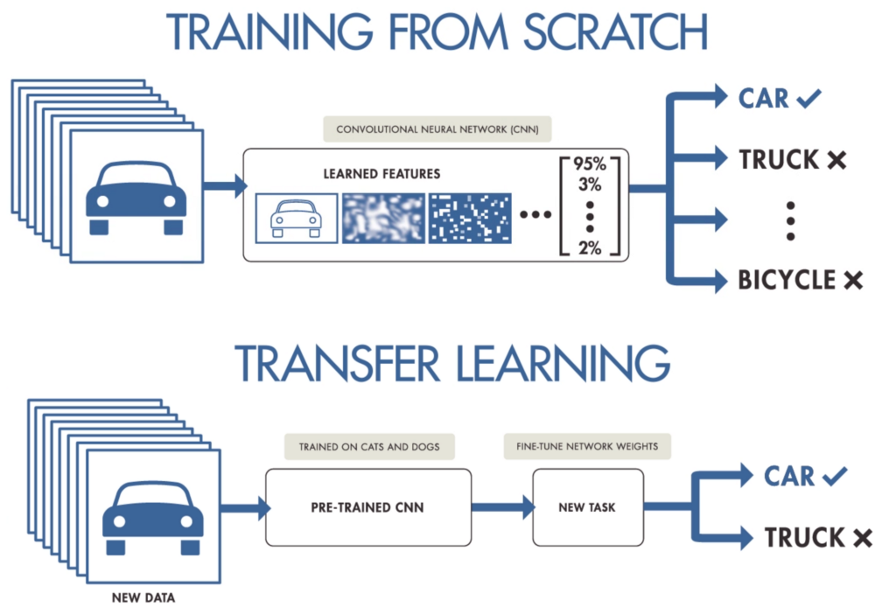
Transfer Learning
Transfer learning is a method that focuses on storing knowledge gained while solving one problem and applying it to a different but related problem.

Slide 6

VGG16
The model achieves 92.7% top-5 test accuracy in ImageNet, which is a dataset of over 14 million images belonging to 1000 classes
Most of the neural network models depend on hyperparameter that makes VGG16 an unique model since instead of having a large number of hyper-parameter they focused on having a uniform structure.
The 16 in VGG16 refers to it has 16 layers that have weights. This network is a pretty large network and it has about 138 million (approx) parameters

Slide 7
Results

Slide 8
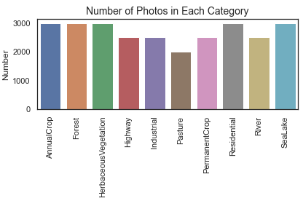
Exploratory Data Analysis (EDA)
EDA is an approach of analyzing dataset to summarize their main characteristics.
Photos by Category-
Pasture- 2000
Industrial, Highway, Permanent Crop, River- 2500
Annual Crop, Sea/Lake, Forest, Herbaceous Vegetation, Residential- 3000
Total Images = 27,000

Slide 9
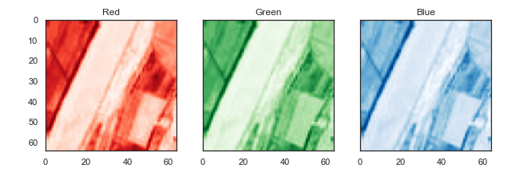
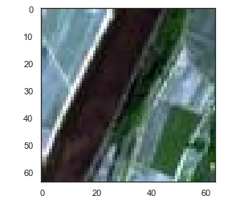
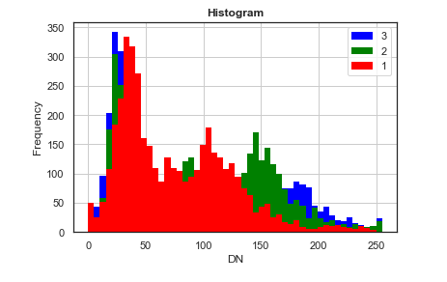
Photos by Color band-
Single band images- does not give much idea
Stacking the same into one image gives us a pleasing and realistic visual

Slide 10
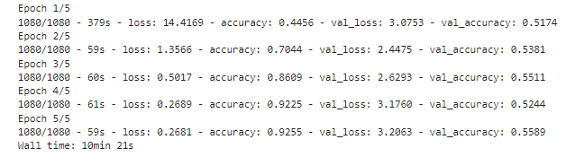
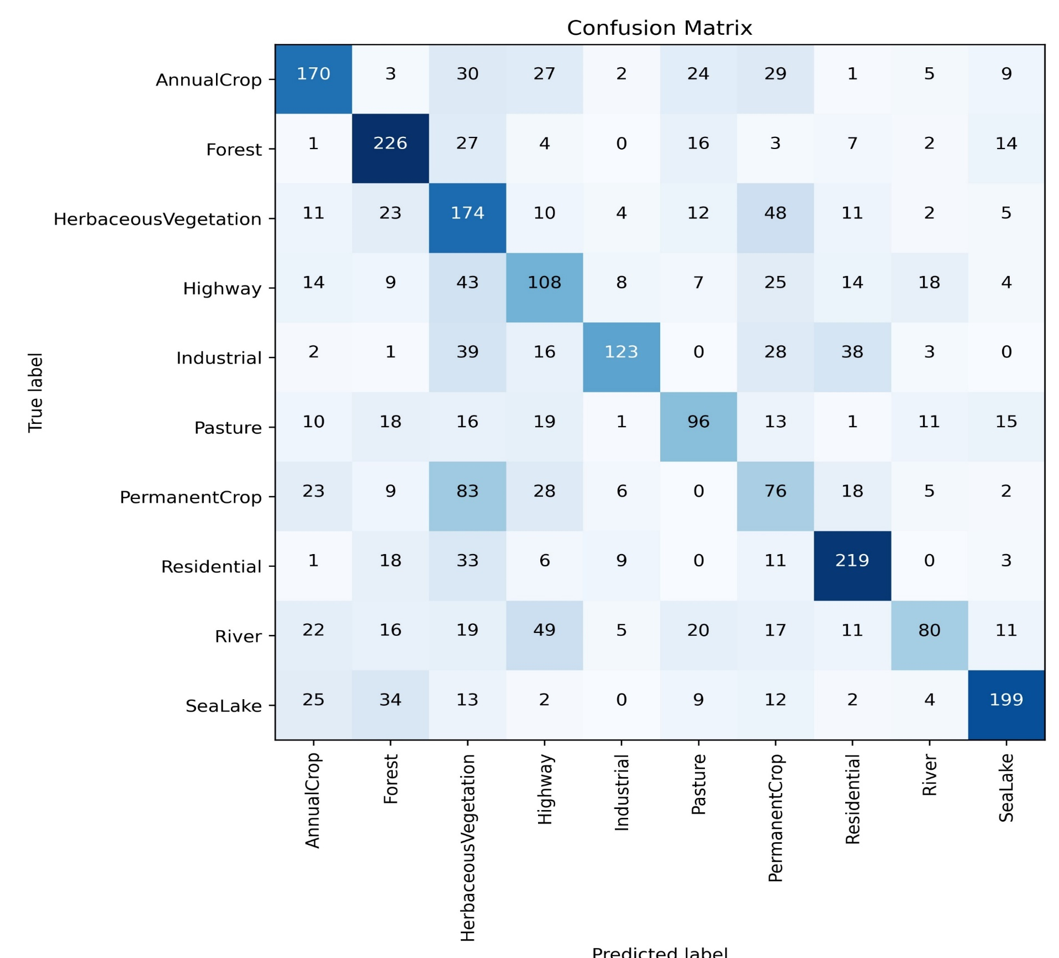
Simple CNN
Run time- 10min 21sec (five epochs)
Training Accuracy- 44.56% to 92.55%
Validation Accuracy- 51.74% to 55.89%
Misclassified largely-
Herbaceous Vegetation as Permanent Crop
Highways as Rivers

Slide 11
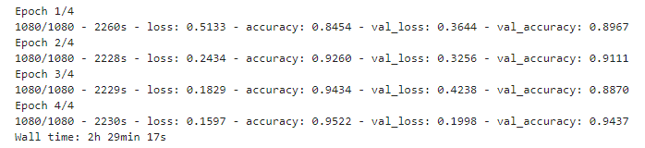
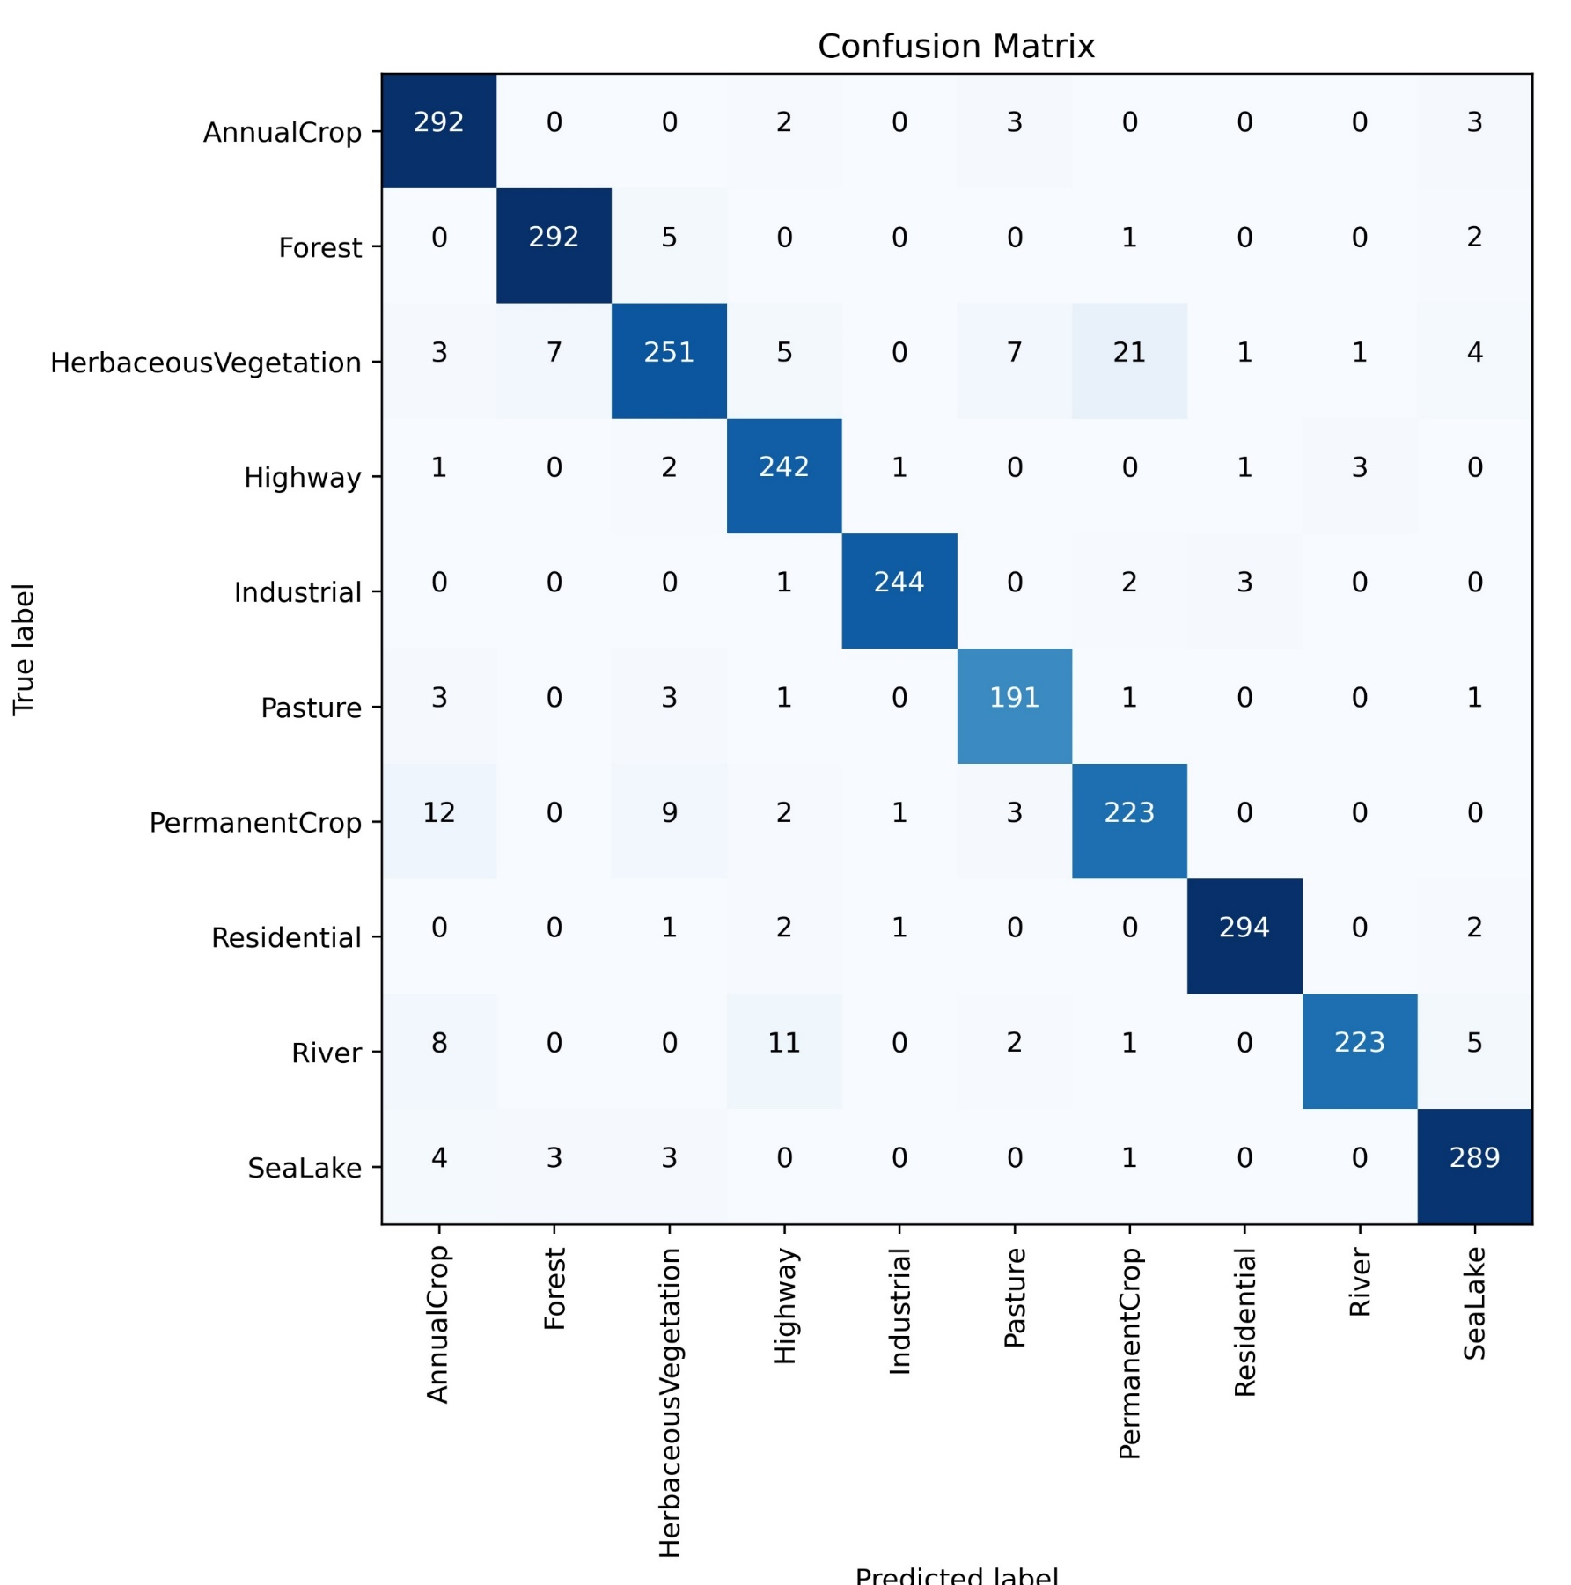
VGG16
Run time- 2hrs 30min (four epochs)
Training Accuracy- 84.54% to 95.22%
Validation Accuracy- 89.67% to 94.37%
With more than 94% validation accuracy the results are clearly visible on test data as well.
Unlike Simple CNN here mostly the predicted classes matched the true class
With more number of epochs the accuracy is expected to flourish

Slide 12
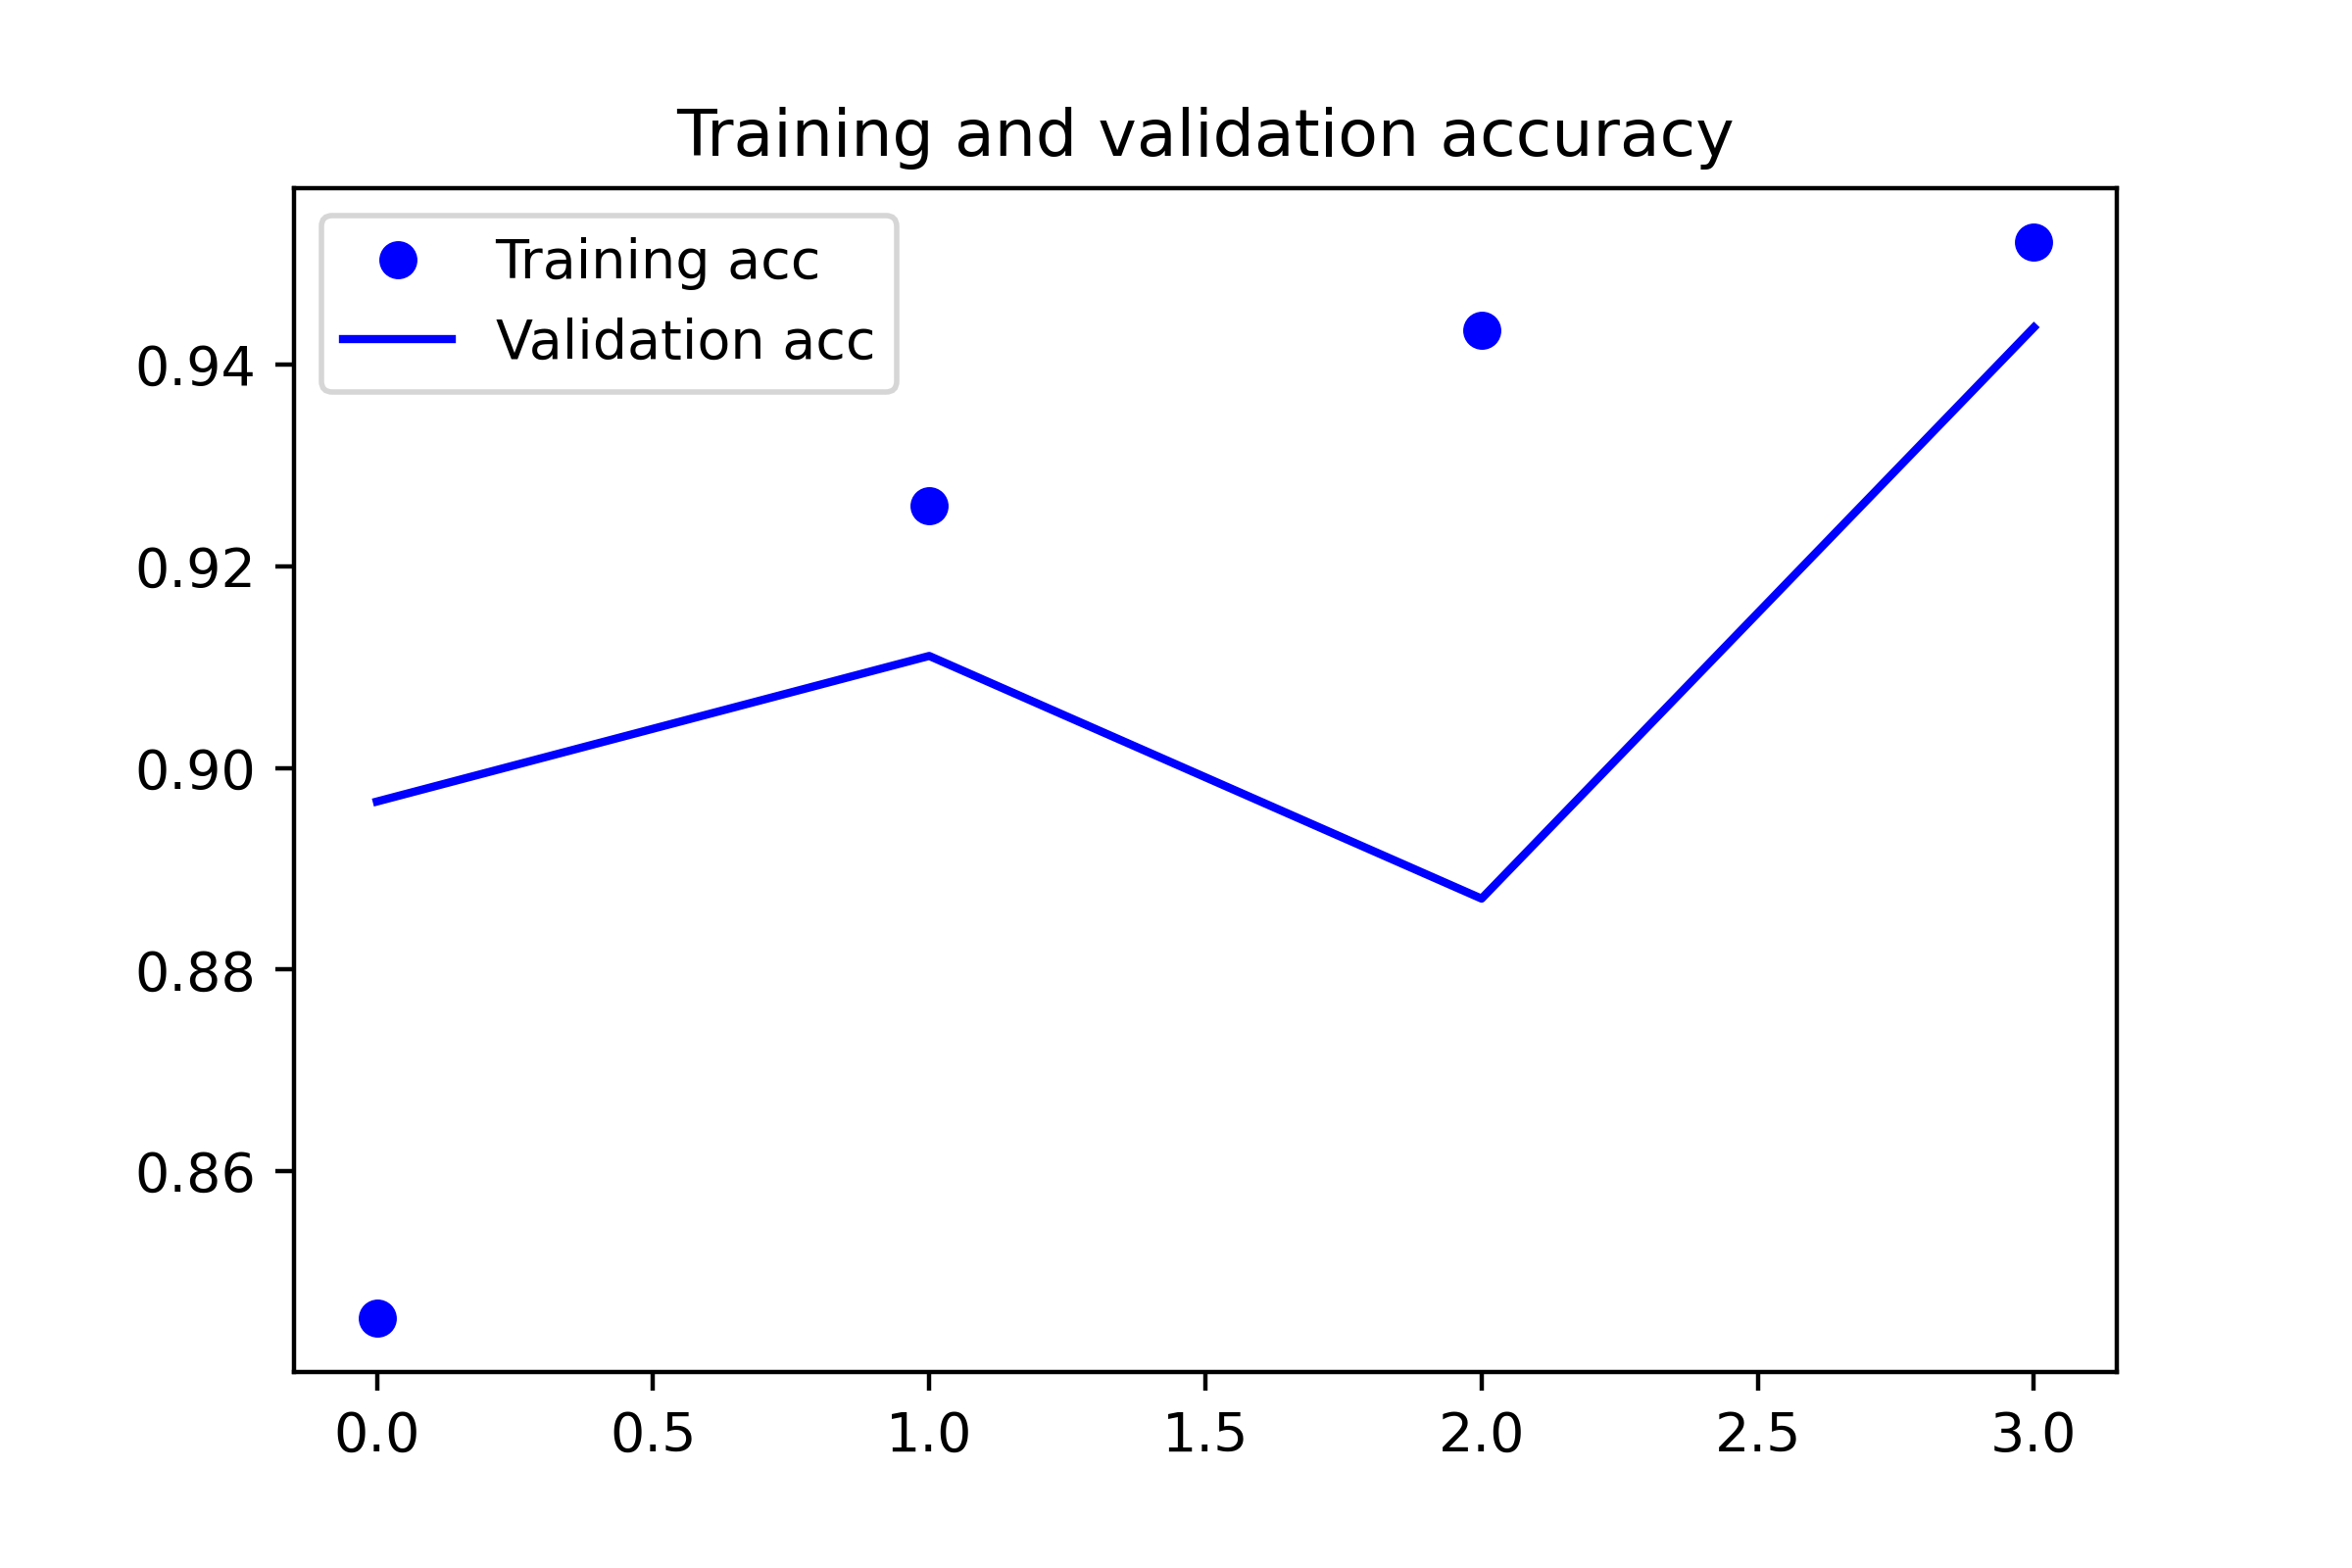
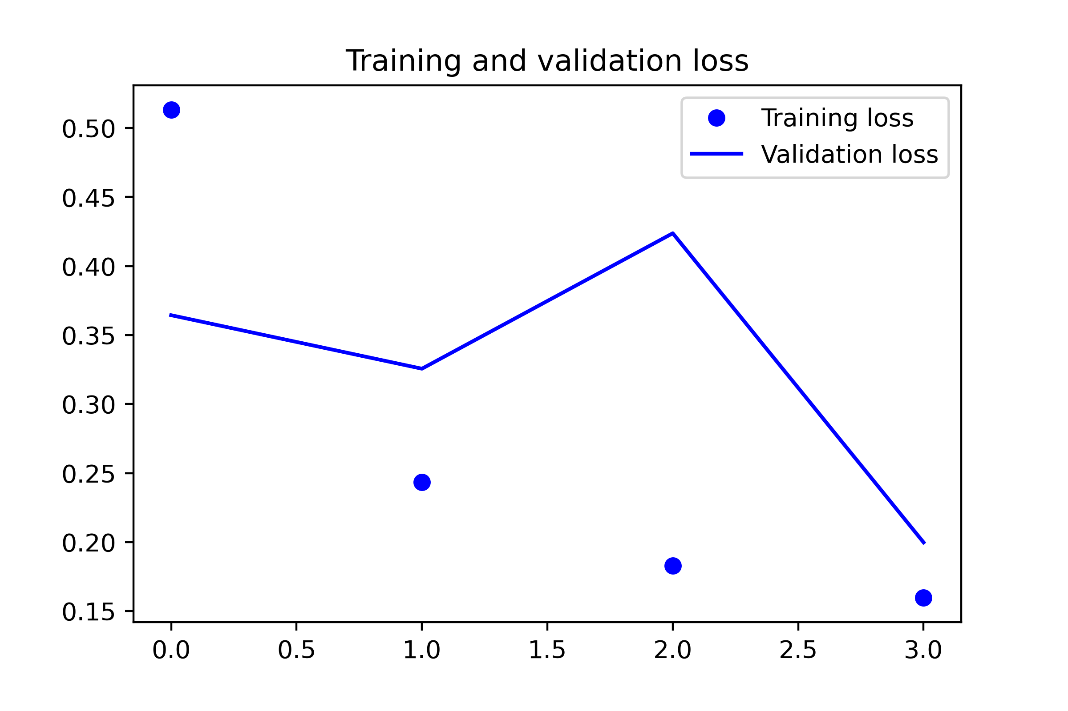
VGG16
Training and Validation Accuracy
Training and Validation Loss
Accuracy
Loss
Number of Epochs
Number of Epochs

Slide 13
Source-
https://towardsdatascience.com/a-laymans-guide-to-building-your-first-image-classification-model-in-r-using-keras-b285deac6572,
last assessed on 23rd Nov, 2021
https://neurohive.io/en/popular-networks/vgg16/
last assessed on 23rd Nov, 2021
https://www.upgrad.com/blog/basic-cnn-architecture,
last assessed on 30th Nov, 2021
https://medium.datadriveninvestor.com/introducing-transfer-learning-as-your-next-engine-to-drive-future-innovations-5e81a15bb567,
last assessed on 30th Nov, 2021

